Slide 1

ABP.IO Platform
v7.2-RC.1
https://blog.abp.io/abp/ABP.IO-Platform-7.2-RC-Has-Been-Published

Slide 2






ABP.IO Platform v7.2-RC.1: GitHub Statistics
140 Issues & PRs closed
692 commits
33 contributors
102 Issues & PRs closed
537 commits
16 contributors
(Planned) Final Release Date: 02 May 2023

Slide 3
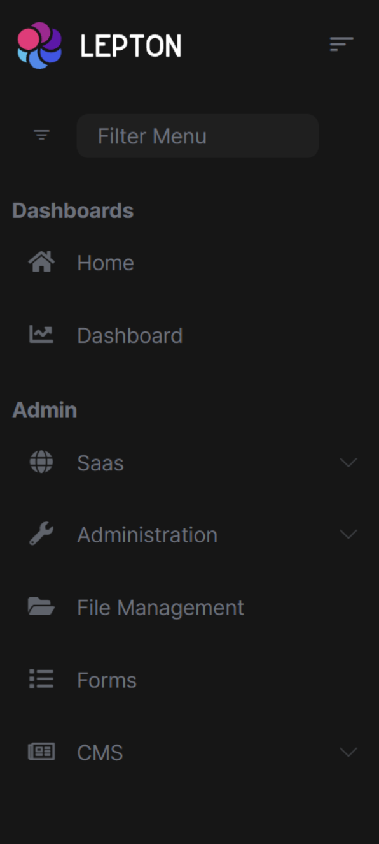
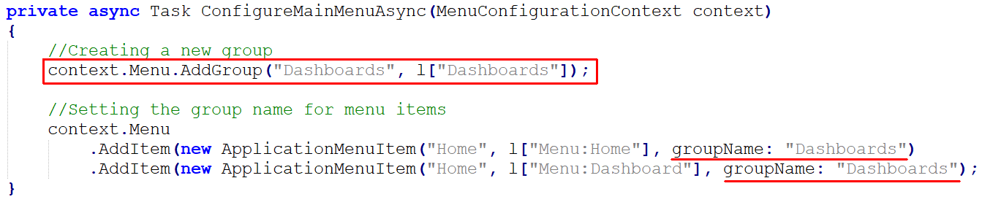
ABP Framework Grouping Menu Items
Documentation
MVC UI https://docs.abp.io/en/abp/7.2/UI/AspNetCore/Navigation-Menu
Angular UI https://docs.abp.io/en/abp/7.2/UI/Angular/Modifying-the-Menu
Blazor UI https://docs.abp.io/en/abp/7.2/UI/Blazor/Navigation-Menu

Slide 4
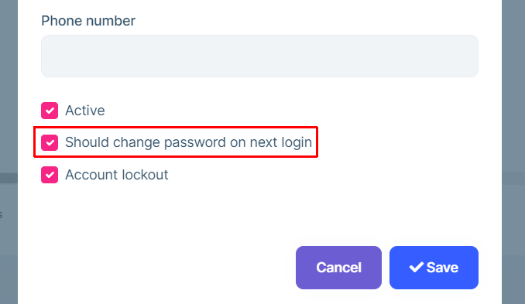
ABP Commercial Force Password Change
Force users to change their passwords.
Identity Management
--> Users
--> Create / Edit User

Slide 5
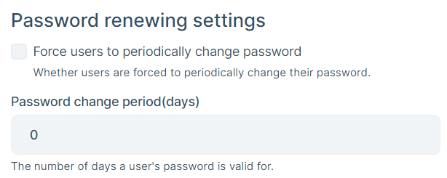
ABP Commercial Force Periodic Password Changes
Force users to periodically change their passwords.
Settings
--> Identity Management
--> Password Settings

Slide 6
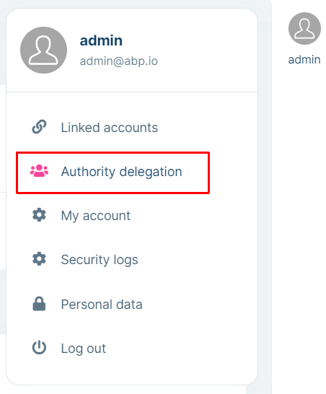
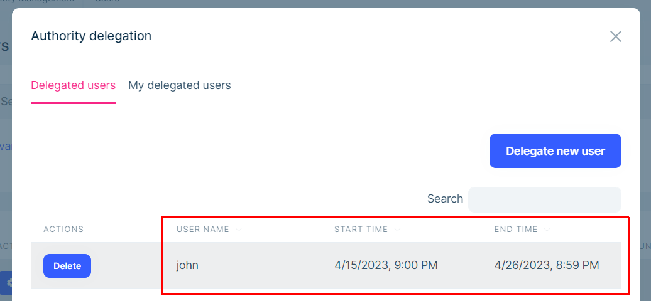
ABP Commercial Authority Delegation
Allow a user to temporary use my account.

Slide 7
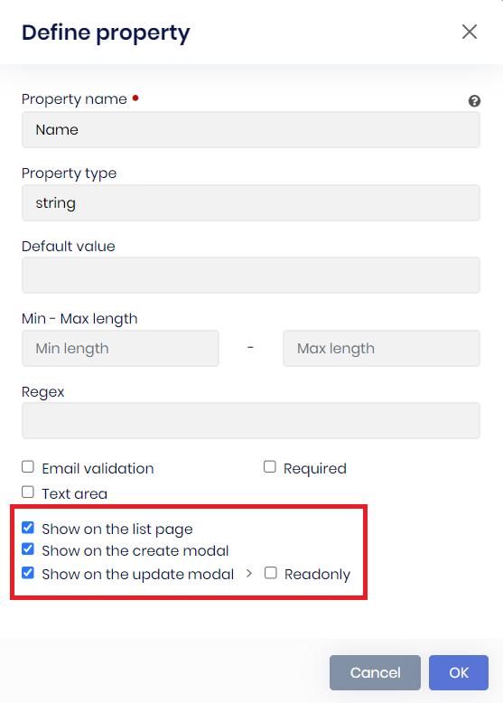
ABP Commercial Suite: Show Properties on Create / Update / List
Allow to show/hide a generated property on the create modal, edit modal and on the data table.

